Slide 1
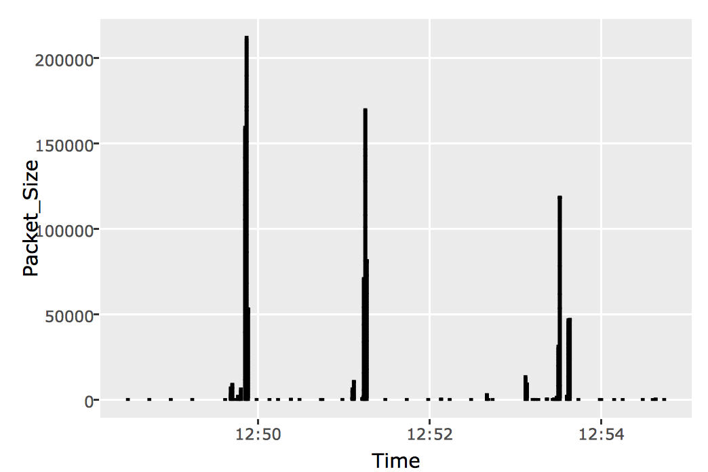
1
Capture traffic
2
Parse traffic
.csv
3
Import data
.pcap
4
Tidy data
5
Visualize data
lists
list

